Slide 1

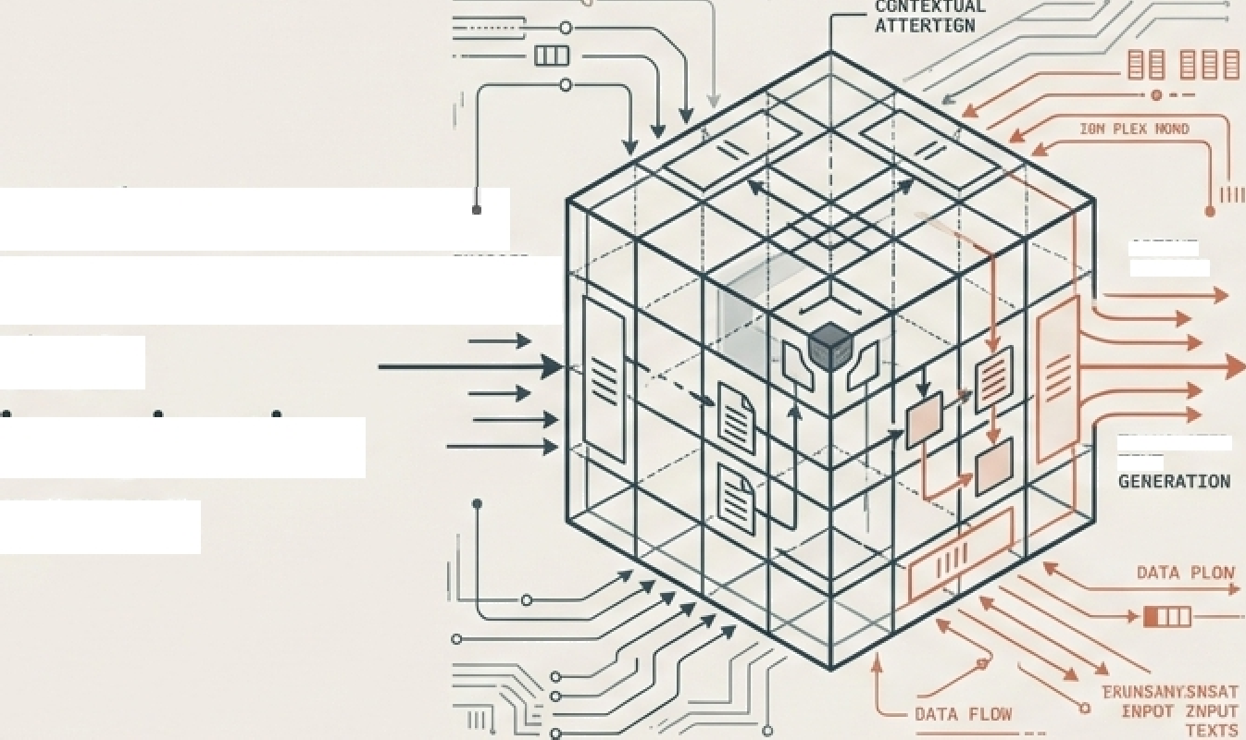









RO3ECTATAGLANCE
Al-Powered Hybrid Translation System
Bridging the English-Hindi Linguistic Gap via T5 and NLLB Architectures
Vijay | Project Report | January 2026
Objective: Zero- shot English to Hindi (Devanagari) translation.
Tech Stack: PyTorch, HuggingFace, SentencePiece.
Students demonstrated their imagination power.
NIP U T
OUTPUT DECODER
Architecture: Hybrid Pipeline (T5 Correction + NLLB Translation).
TRAIN BLATE D T ENT
Key Result: chrF++ Score: 47.43 (High morphological Accuracy).

Slide 2
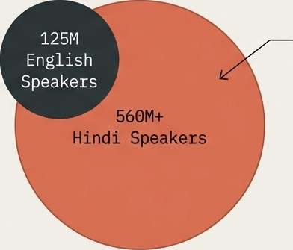
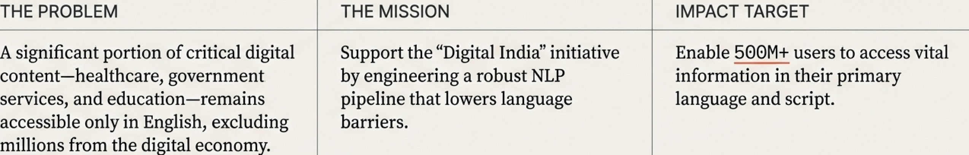
The Challenge: India's Digital Divide
The Accessibility Gap

Slide 3
Data Engineering: The IITB Corpus & Preprocessing
Dataset Specs
Source Dataset: IITB English-Hindi Parallel Corpus (-1.6M sentence pairs).
Domain Coverage: News, Literature, Government Documents.
Tokenization
(SentencePiece)
Raw Text
Language Forcing
Model Ready
Hello world
[ _He, llo, _wor,
{orced bos token id = hin Deva
Tensor Input
Subivord Units for OOV handling
**Why SentencePiece?**
Handles Out-Of-Vocabulary words critical for multilingual contexts.
”"Why Forced BOS?**
Forces the decoder to initiate generation in Devanagari script, preventing Romanized output.

Slide 4

System Architecture: The Intelligent Pipeline
STAGE 1: GRAMMAR CORRECTION
STAGE 2: NEURAL TRANSLATION
Noisy Input
Model: TS- Base (220N)
Clean English
Model: NLLB -200 D1st1lled (600M)
Hindi Output
i am going school
I am going
to school.
Standard translators often fail on user typos. Our hybrid approach introduces an ‘Editor’ model (T5) to standardize input before the ‘Translator’ model (NLLB) processes it.

Slide 5
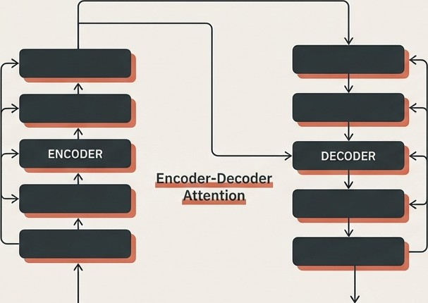
Deep Dive I: Grammar Correction(T5)
The Editor Brain
Model: ven nify/t5- base - gza+oa r - correction ( 220M Params).
Concept: Text-to-Text Transfer
Transformer.
The Logic: TS treats every NLP problem as a text generation task. By prefixing the input with 'lix gra++ar:’, we leverage pre-training to standardize punctuation and capitalization.
Impact: Clean Input = Better Translation cues for the downstream model.
fix grammar: i am studing AI
I am studying AI.

Slide 6
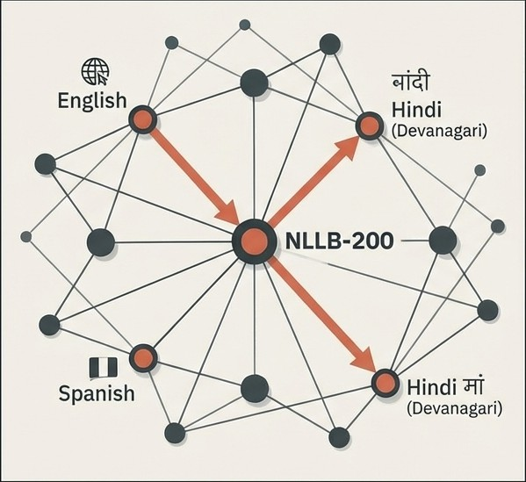


Neural Machine Translation (NLLB)
Deep Dive:
The Translator Brain
Model: Zacebook/nllb-200-distilled-600M.
Concept: Sequence-to-Sequence (Seq2Seq)
Generation.
Key Specs:
Multilingual Support: 200+
Languages.
Script
Support: Natìre Deranagari.
Architecture: Distilled 600M parameters (vs
3.3B)
for
efficiency.
Why Distilled?
Offers a strategic
balance between state-Of—the-
art accuracy and inference speed, optimized
for
low-resOurce
languages.

Slide 7
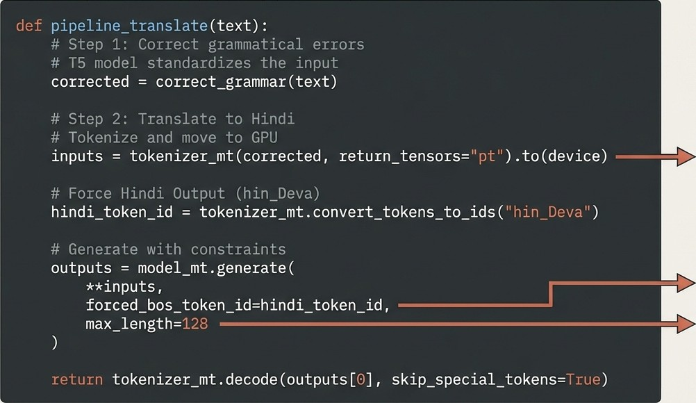
Core Implementation: The Translation Logic
Device Agnostic (CPU/GPU)
Script
Enforcement
Sequence Control

Slide 8

Evaluation & Analysis: Metrics that Matter
Engineering Editorial
BLEU
15. 19
chrF++
47. 43
TER
71. 93
METEOR
0.32
Why chrF++ wins (47.43):
Character F-score is superior for morphologically rich languages like Hindi. It captures the root meaning even if the inflection changes.
Real World Result
Input: “fictitious fort Duttgarh"
Prediction: " ."
Analysis: Correctly transliterated the proper noun 'Duttgarh'.
Why BLEU is low (15.19):
BLEU relies on exact n-gram matching. Hindi's flexible word order
penalizes BLEU scores despite semantic accuracy.

Slide 9



Responsible AI: Ethics & Bias
Engineering Editorial
Regional Gaps
Training data (Khari Boli) excludes dialects like Bhojpuri or Awadhi. The system performs best
on standard government/news text
Limitation: Reduced
accuracy for colloqulalisms.
Gender Bias
Hindi has grammatical gender. The model currently defaults to masculine forms (e.g., ‘I am a teacher’ —+ Jf ’).
X 1tigation : Future context - amaze pzonpzs .
Deployment Safety
Privacy First. The system uses local inrerence logic, ensuring no user data is logged to the cloud.
Standard: GDPR Compliance
ready.

Slide 10

Conclusion & Future Roadmap
Engineering Editorial
Current State
Hybrid Pipeline Active
chrF++ Score: 47.43
Robust Devanagari Rendering
Short Term
Web Interface (Gradio)
INT8 Ciuantization (Edge
Future Vision
Speech-to-Speech (ASR +
TTS)
Bidirectionai Support
(Hindi -> English)
optimization)
Mobile App (React Native)
Moving beyond translation to true digital inclusion for the next billion users.

